Slide 1
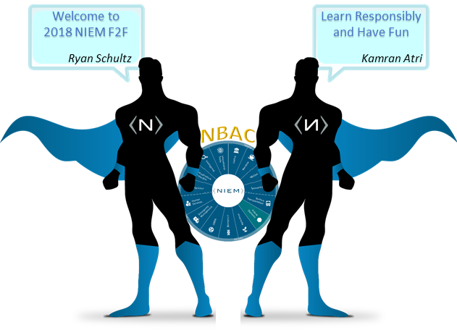
2018 NBAC F2F Meeting
Enabling Connected Future Now
10/29/2018

Slide 2
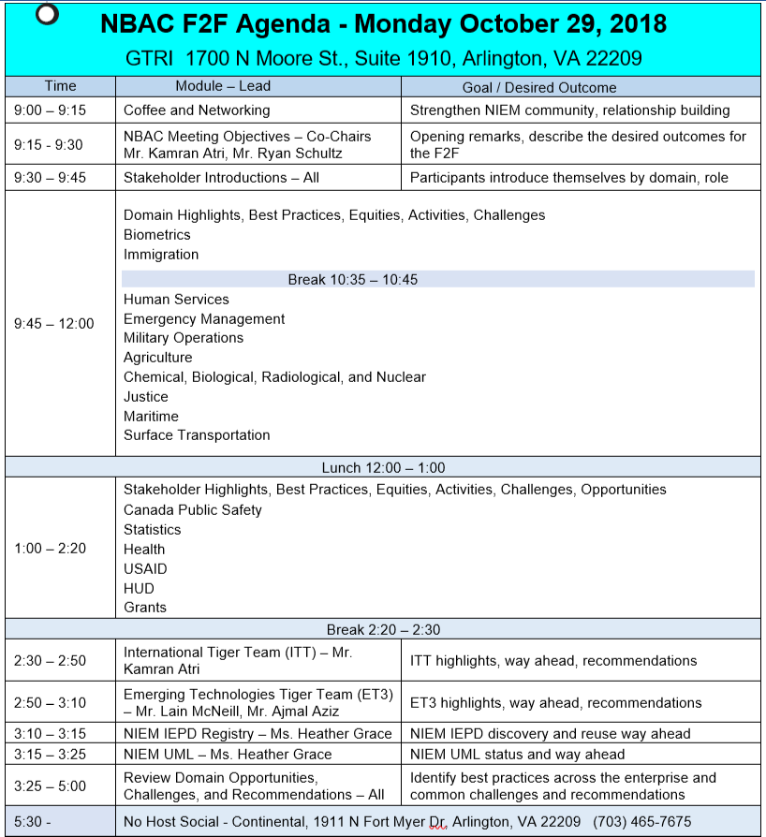
Agenda (Oct 29):

Slide 3
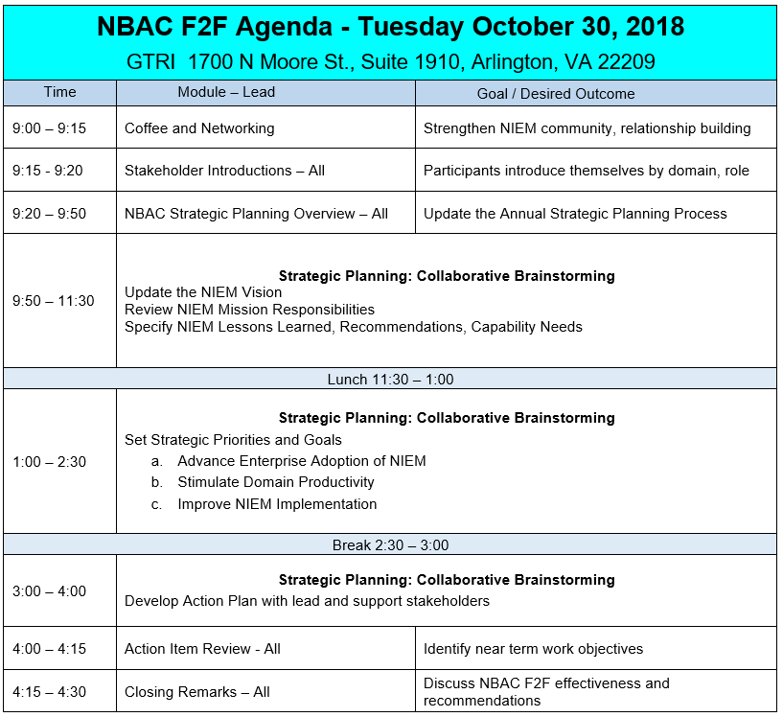
Agenda (Oct 30):

Slide 4
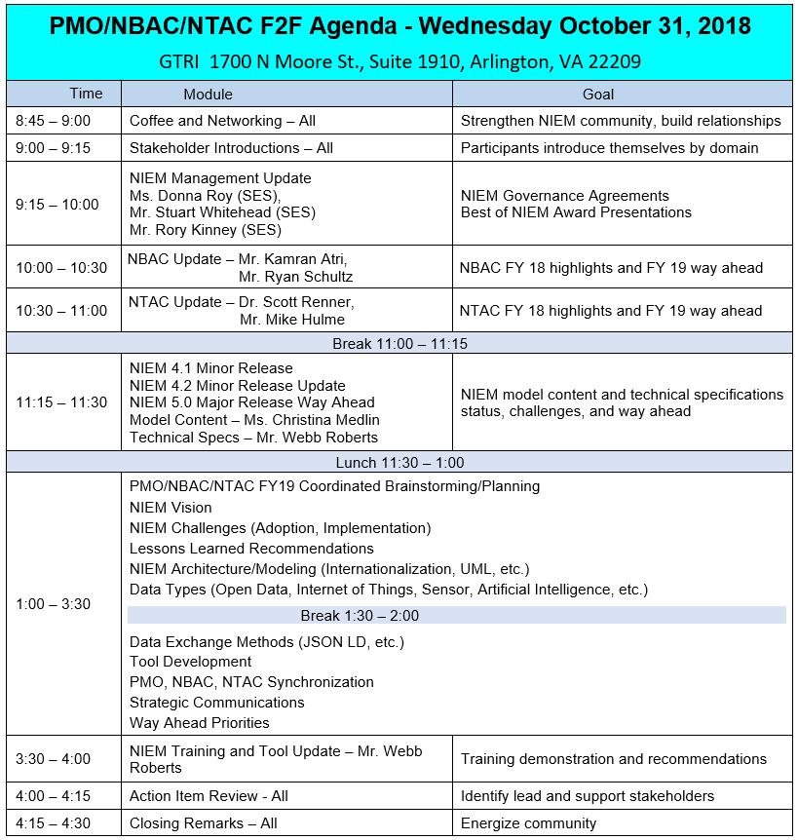
Agenda (Oct 31):

Slide 5
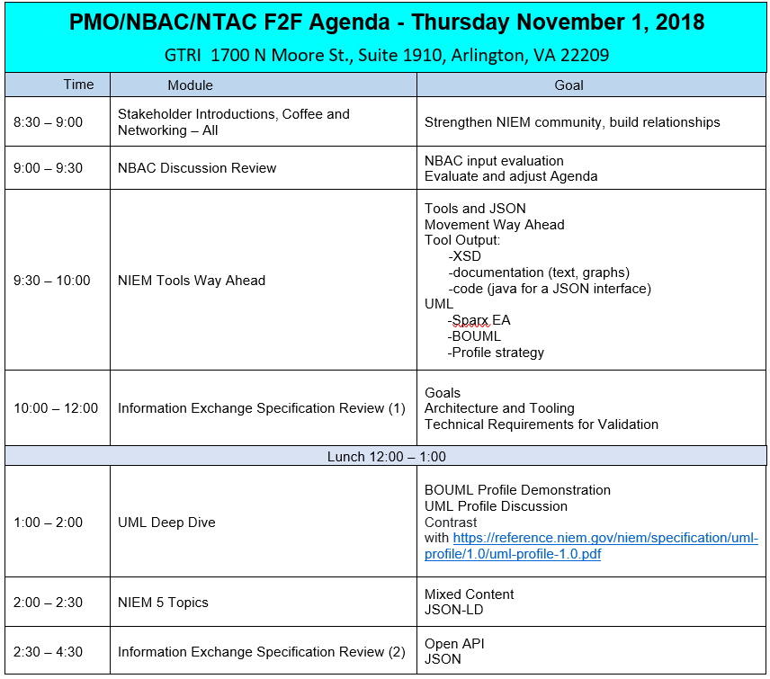
Agenda (Nov 01):

Slide 6
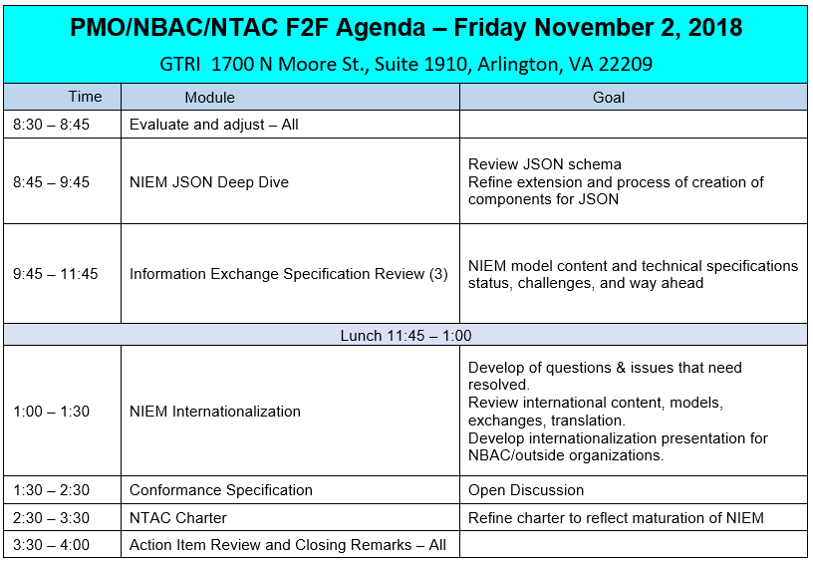
Agenda (Nov 02):

Slide 7
Reminder:
Well-informed decisions will be taken, recorded, and carried out.
Your full participation is a must to ensure success.
Following the agenda we all agreed on, with time limits on topics.
Hear to learn from one another with open mind.
Don’t be shy, speak up when you have something to say.
Ask questions if you are unclear or unsure… share your views.
We will abide by decisions which will be decided during this NBAC/NTAC F2F, whether we agree with them or not.
Sometimes its lonely out there, build your network here with you fellow data standards guru.
Every NBAC member is directly part of the NIEM decision-making process.

Slide 8
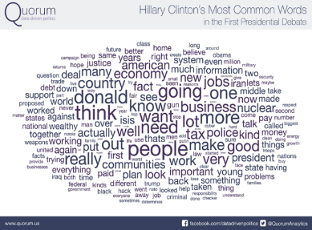


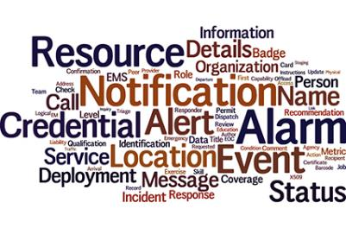


Questions?
Presented by:
Kamran Atri & Ryan Schultz
Co-Chairs of NIEM Business Architecture Committee (NBAC)
katri@A4SAFE.COM
ryan.r.schultz.civ@mail.mil

